Slide 1
Levels of Measurement, Measures of central Tendency & Dispersion

Slide 2
Descriptive / Inferential Statistics
Descriptive Statistics:
Used when we are only interested in the specific group from which the measurements are taken. Much business data will be descriptive in nature.
Inferential Statistics:
Used to infer something about the population when we only have the data from a sample.
The sample is analysed to produce the sample summary statistics from which we can infer values for the parent population.
The summary statistics from the sample are usually referred to as the sample statistics and the corresponding measure estimated for the population as a population parameters.

Slide 3
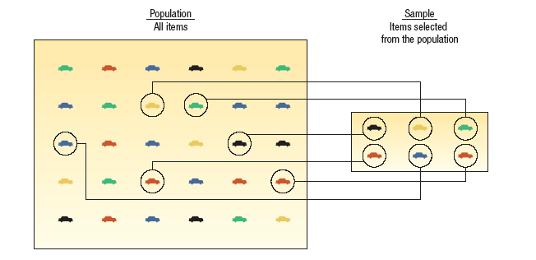
Population & Sample
The population is the entire group of interest, whether people or things.
It is not usually possible, or not practical, to examine every member of a population.
A sample, a smaller selection taken from that population, is used to estimate some value for the whole population.
The sample must be representative of the whole population of interest.
A census, gathers data from the whole population, e.g. the ten year census.
A survey gathers data from only a sample taken from the population of interest.

Slide 4
Parameter vs. Statistic
PARAMETER A measurable characteristic of a population.
STATISTIC A measurable characteristic of a sample.

Slide 5
Sampling
During World War II, the Royal Air Force asked Abraham Wald, a statistician, to help decide where armour should be added to the UK's bombers. The RAF gave Wald information about which parts of its planes were typically hit.
Armour is heavy and can only be added to certain parts of the planes - but to which parts?
What should the statistician’s response to this problem be?
Section of Plane | Bullet Holes per Square foot
Engine | 1.11
Fuselage | 1.73
Fuel System | 1.55
Wings | 1.8

Slide 6
Levels of Measurement of Data
Categorical Variables (entities are divided into distinct categories):
Dichotomous variables are categorical variables with two categories or levels (e.g. dead or alive)
Variables assigned either a 0 or a 1 are said to be in a binary state. For example Male (0) and female (1).
Nominal variable: There are more than two categories
e.g. whether someone is an omnivore, vegetarian, vegan, or fruitarian.
Ordinal variable: The same as a nominal variable but the categories have a logical order
e.g. whether people got a fail, a pass, a merit or a distinction in their exam.

Slide 7
Levels of Measurement of Data
Continuous variables (entities get a distinct score):
Interval variable: Equal intervals on the variable represent equal differences in the property being measured
e.g. the difference between 6 and 8 is equivalent to the difference between 13 and 15.
Ratio variable: The same as an interval variable, but the ratios of scores on the scale must also make sense
e.g. a score of 16 on an anxiety scale means that the person is, in reality, twice as anxious as someone scoring 8.

Slide 8
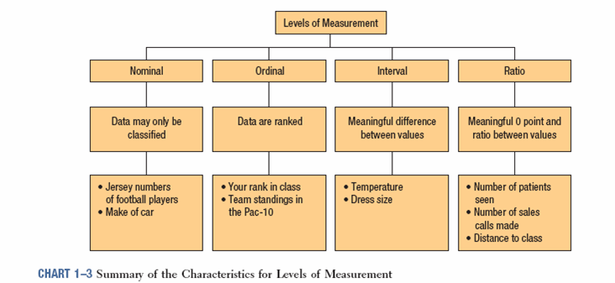

Slide 9
A Set of data is often summarised and described by two parameters:
a Measure of Centrality
a Measure of Spread

Slide 10
Measures of Central Tendency:
Common Measures
Mean
Arithmetic
Weighted
Geometric
Mode
Median
Notes:
4

Slide 11
Arithmetic Mean
Mean is the average of a group of numbers
Applicable for interval and ratio data
Not applicable for nominal or ordinal data
Affected by each value in the data set, including extreme values
Notes:
11

Slide 12
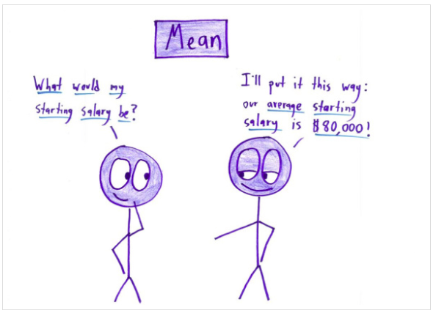
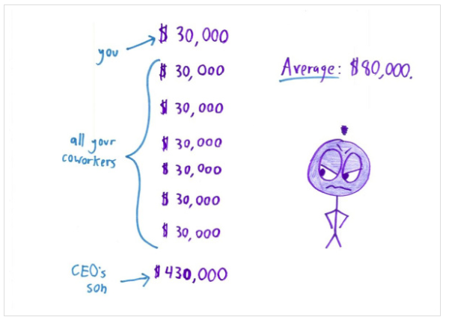

Slide 13
Median
Median - middle value in an ordered array of numbers.
The midpoint of the values after they have been ordered from the smallest to the largest, or the largest to the smallest.
For an array with an odd number of terms, the median is the middle number
For an array with an even number of terms the median is the average of the middle two numbers
Example: Number of days during which nine members of staff did not use their cars:
2 6 2 4 1 4 3 1 1
In order: 1 1 1 2 2 3 4 4 6
Mode: 1 Median: 2 Mean:
Notes:
7

Slide 14
Mode
Mode - the most frequently occurring value in a data set
Applicable to all levels of data measurement (nominal, ordinal, interval, and ratio)
Can be used to determine what categories occur most frequently
Bimodal – In a tie for the most frequently occurring value, two modes are listed
Multimodal -- Data sets that contain more than two modes
Notes:
5

Slide 15
Geometric Mean (e.g when calculating compound returns)
The geometric mean is is a time-weighted average defined as shown below.
Example
Year 1 return: 15%, Year 2 return: -30%, Year 3 return: 21%
Geometric mean:
1+Rg = 0.9913
Rg = -0.0087 (-0.87%)

Slide 16
Relative Position of Mean, Median & Mode
Mean
Mode
Mean
Median
Mode
Mode
Mean
Median
Median
Negatively
Skewed
Symmetric
(Not Skewed)
Positively
Skewed

Slide 17
Measures of Spread or Variability:
Measures of Variability - describe the spread or the dispersion of a set of data.
Provides more meaningful data when used with measures of central tendency
Common Measures of Variability
Range
Interquartile Range
Mean Absolute Deviation
Variance
Standard Deviation
Notes:
22

Slide 18
Range
The difference between the largest and the smallest values in a set of data
Advantage – easy to compute
Disadvantage – is affected by extreme values

Slide 19
Quartiles
Quartile - measures that divide a group of data into four subgroups
Q1: 25% of the data set is below the first quartile
Q2: 50% of the data set is below the second quartile
Q3: 75% of the data set is below the third quartile
Q₁
Q₂
Q₃
25%
25%
25%
25%
Notes:
17

Slide 20
Interquartile Range
Interquartile Range - range of values between the first and third quartiles
Range of the “middle half”; middle 50%
Useful when researchers are interested in the middle 50%, and not the extremes
Interquartile Range – used in the construction of box and whisker plots
Notes:
37

Slide 21
Interquartile Range: Example
Number of days during which nine members of staff did not use their cars:
2 6 2 4 1 4 3 1 1
In order: 1 1 1 2 2 3 4 4 6
Interquartile range: First quartile ¼ of (9+1)
= 2.5th value = 1 day
Third quartile ¾ of (9+1)
= 7.5th value = 4 days
IQR: 4 – 1 = 3 days

Slide 22
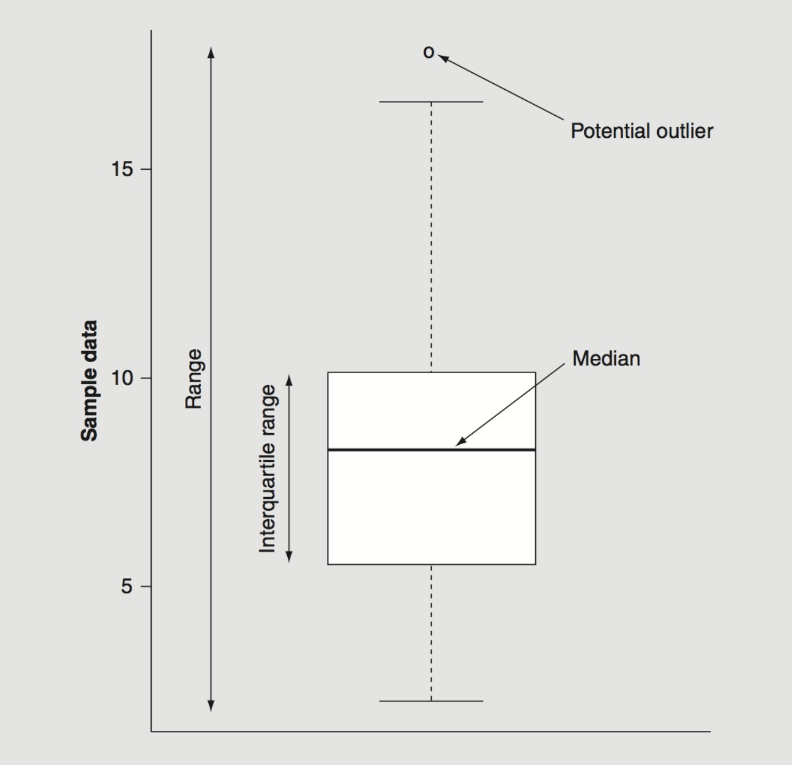
Visualising Data with a Boxplot (aka Box & Whisker Plot)

Slide 23
Mean Absolute Deviation, Variance, and Standard Deviation
These data are not meaningful unless the data are at least interval level data
One way for researchers to look at the spread of data is to subtract the mean from each value in the data set
Subtracting the mean from each data value gives the deviation from the mean (X - µ)
An examination of deviation from the mean can reveal information about the variability of the data
Deviations are used mostly as a tool to compute other measures of variability
The Sum of Deviation from the arithmetic mean is always zero
Sum (X - µ) = 0

Slide 24
Mean Absolute Deviation
A way to force the sum of deviations to have a non zero total is to take the absolute value of each deviation around the mean
Allows one to solve for the Mean Absolute Deviation
Mean Absolute Deviation - average of the absolute deviations from the mean
5
9
16
17
18
-8
-4
+3
+4
+5
0
+8
+4
+3
+4
+5
24

Slide 25
Population Variance
Variance - average of the squared deviations from the arithmetic mean
Population variance is denoted by σ²
Sum of Squared Deviations (SSD) about the mean of a set of values (called Sum of Squares of x)

Slide 26
Population Variance
Variance = average of the squared deviations from the arithmetic mean
Population variance is denoted by σ²
5
9
16
17
18
-8
-4
+3
+4
+5
0
64
16
9
16
25
130
Notes:
26

Slide 27
Sample Variance
Sample Variance - average of the squared deviations from the arithmetic mean
Sample Variance – denoted by S²
2,398
1,844
1,539
1,311
7,092
625
71
-234
-462
0
390,625
5,041
54,756
213,444
663,866
Notes:
28

Slide 28
Sample Standard Deviation
Sample Std Dev is the square root of the sample variance
2,398
1,844
1,539
1,311
7,092
625
71
-234
-462
0
390,625
5,041
54,756
213,444
663,866
Notes:
29

Slide 29
Levels of Measurement, Measures of central Tendency & Dispersion
See:
Chapter 3 of Lind, Marchal, Wathen. Basic Statistics for Business & Economics (International Edition) 8e
Chapter 3 of Cortinhas, C. & Black, K. 2012. Statistics for Business & Economics (First European Edition).

